Slide 1
REACTIVE LED SYSTEM
CULMINATION PROJECT CITY TECH
2025 / FALL / NOVEMBER 4
Jay J Gurung

Slide 2
REACTIVE LED SYSTEM
Contents
Jay J Gurung
1.
PRODUCT DESIGN INSPO & SKETCH
2.
SYSTEM UPGRADE & EXPANSION
3.
PCB DESIGN - KiCad
4.
ENCLOSURE DESIGN - Autodesk Fusion
5.
NEXT STEPS

Slide 3
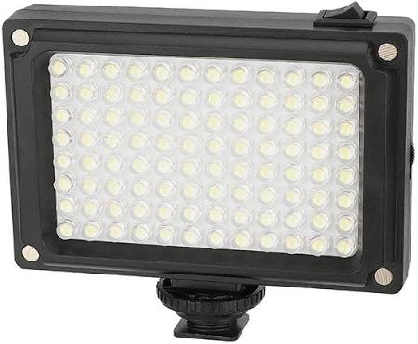
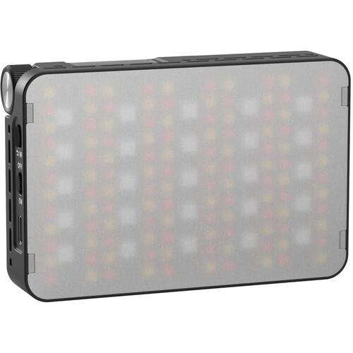
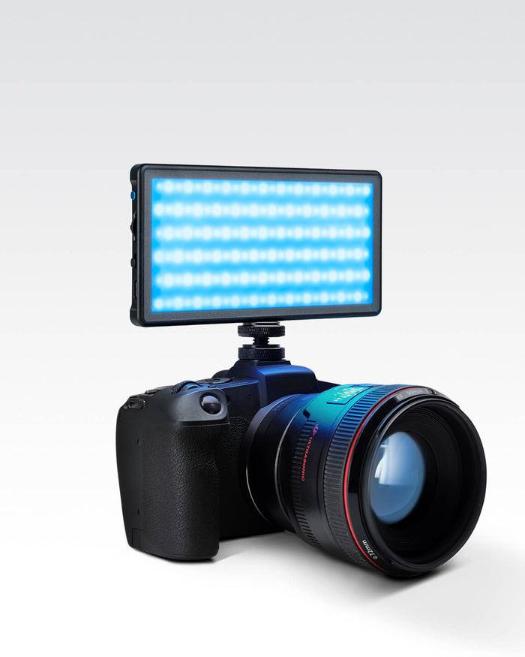
REACTIVE LED SYSTEM
1. PRODUCT DESIGN INSPIRATIONS
CAMVATE 96led Camera Video Fill Light
SmallRig RM 25C Mini LED Video Light
RGB PANEL PRO 2.0
Jay J Gurung
SIMPLE LED with magnetic filter attachment, white or yellow temperature.
Runs on 2 AA batteries
Price $20
Link
Rechargable.
Adjustable Color Temp knob
Price $60
Link
Controllable via App
RGB Colors
Rechargeable
Price $149
link

Slide 4
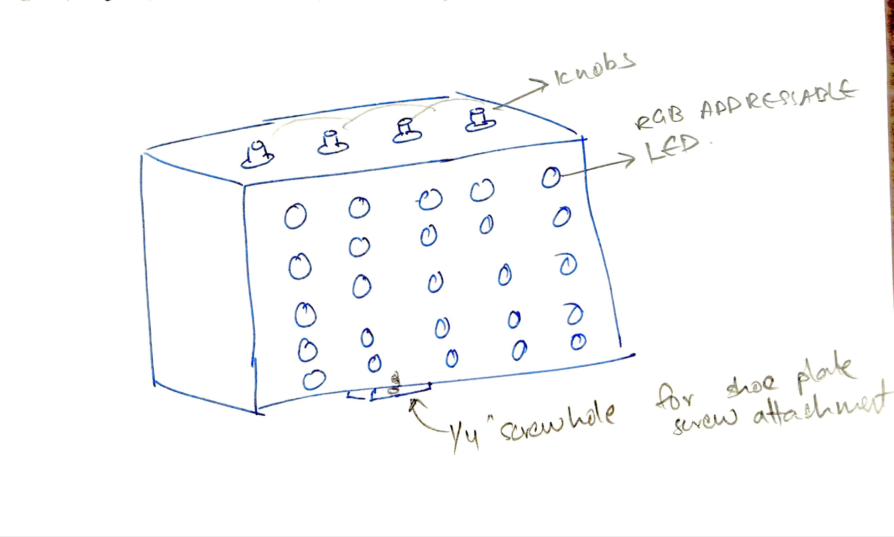
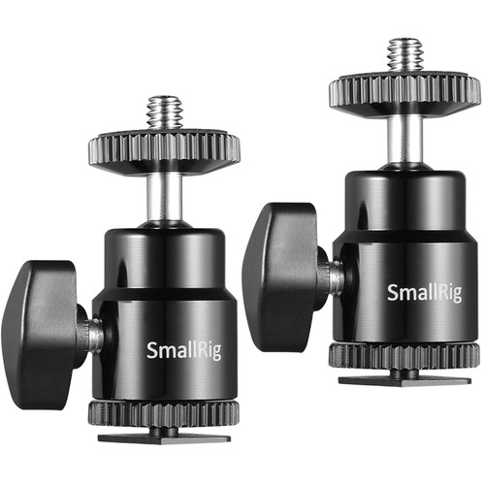
REACTIVE LED SYSTEM
1. PRODUCT DESIGN SKETCH
Jay J Gurung

Slide 5
Company Name
2. SYSTEM EXPANSION
Changes Made
What It Does
Expanded from 5 LED to 25
5 LEDs are mapped to each bandwidth instead of 1 LED for each bandwidth.
Adds more brightness.
1
Expanded from 1 control knob to 4 pots.
System scalability.
Will be adding more features.
2
Arduino IDE Sketch 3.0
Updated the sketch to account for addressable LED to work with 25 LEDS. Updated the sketch to account for 3 new pots. Functions not assigned yet.
3
Jay J Gurung

Slide 6
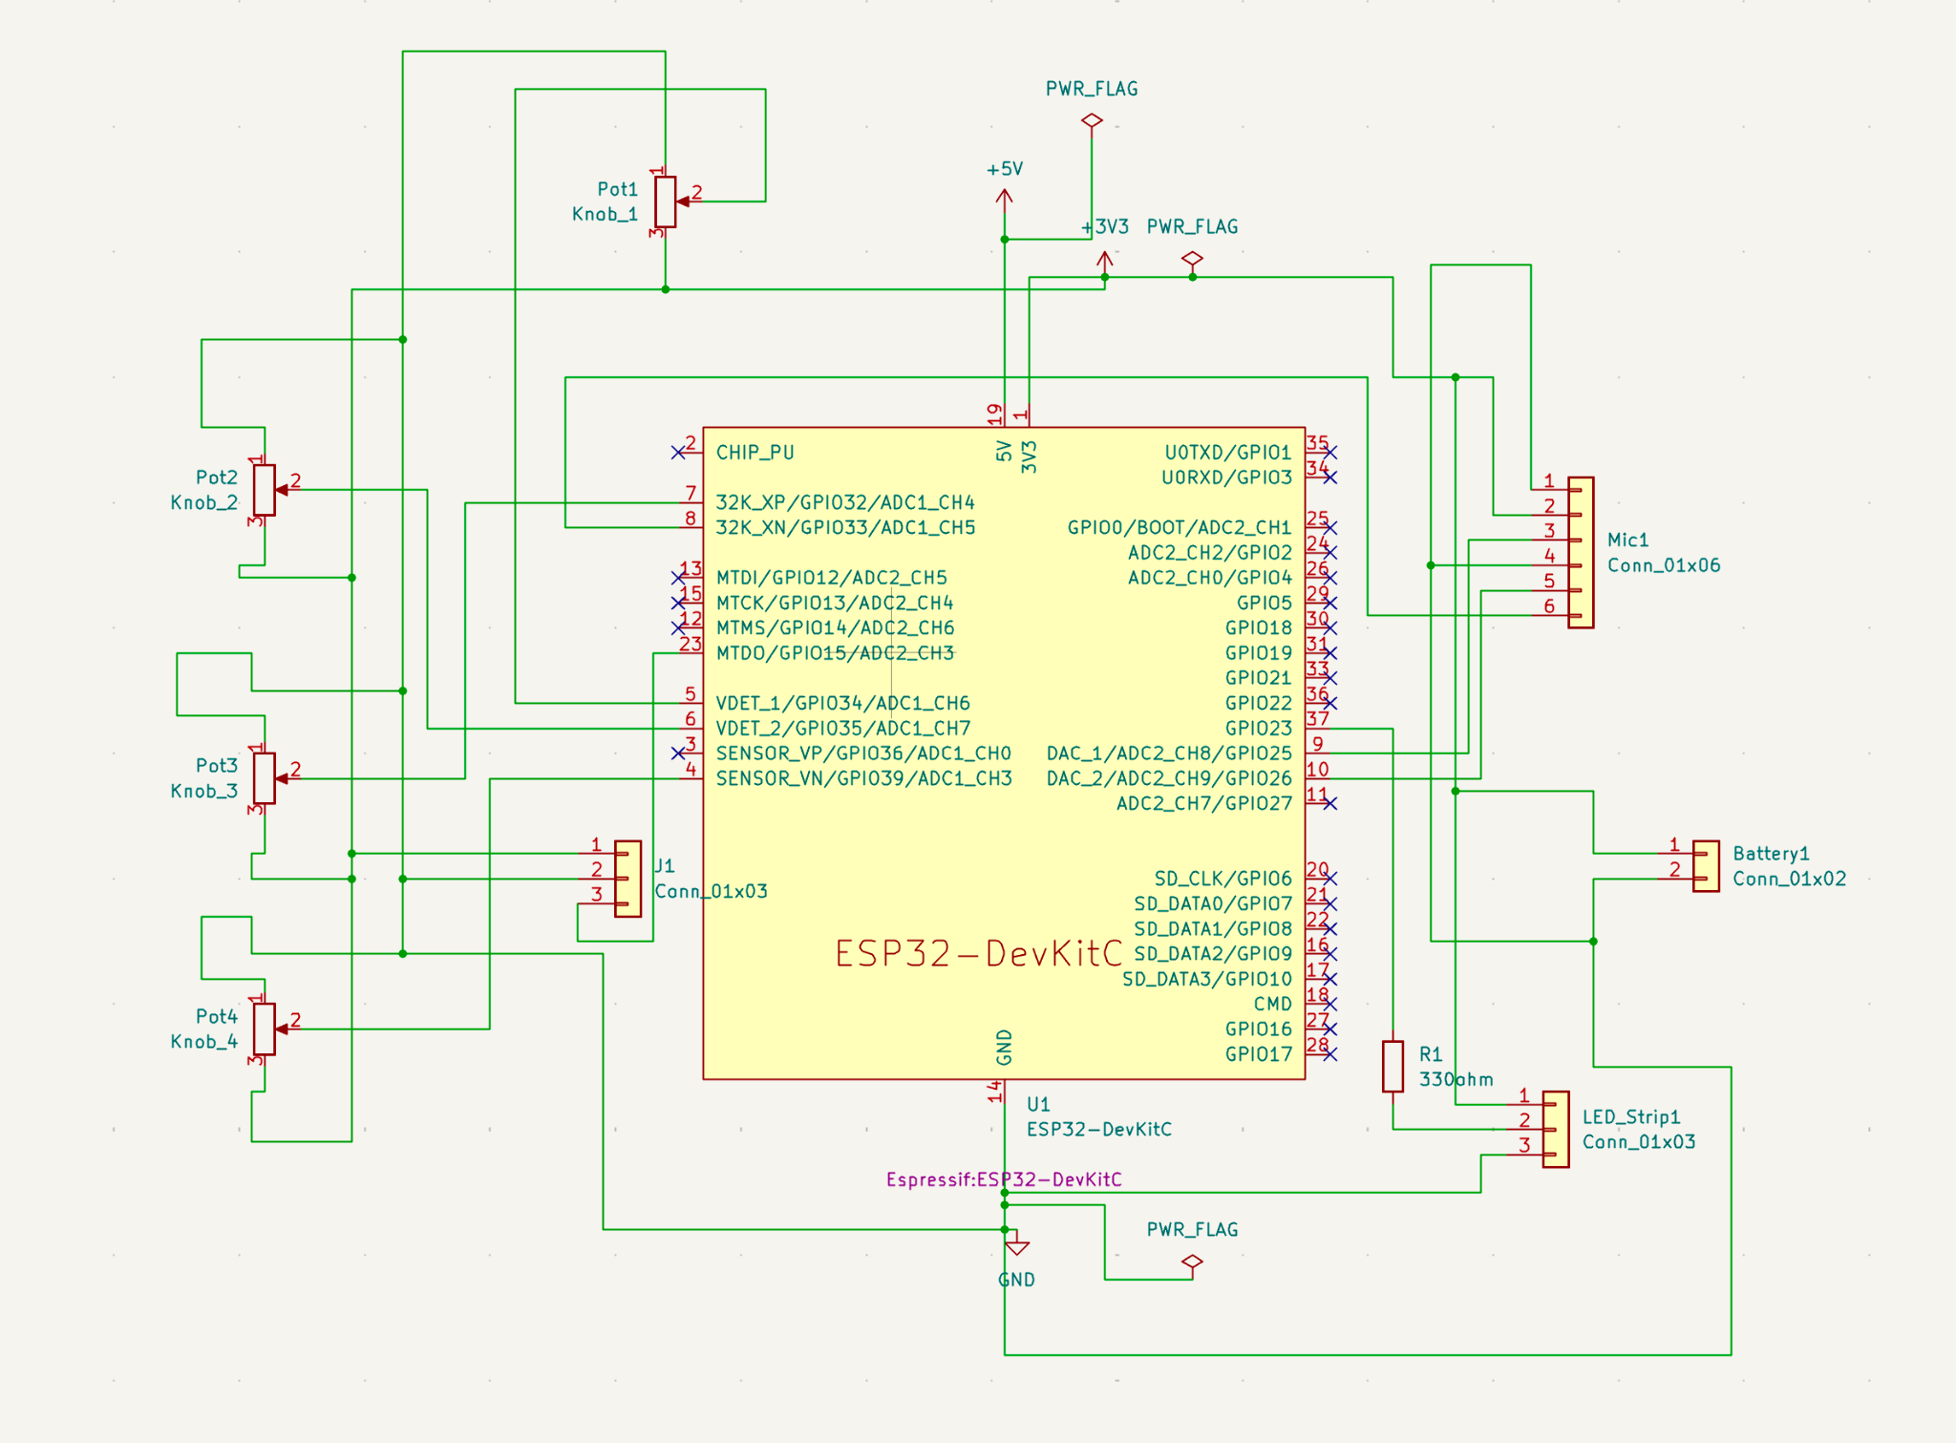
REACTIVE LED SYSTEM
3. PCB DESIGN - SCHEMATICS
Jay J Gurung
Chose and imported symbols for all key parts
Set correct electrical pin types (power, input, passive, etc.) and assigned footprints for each component.
Connected components using wires for clear visual routing of power, data, and control signals.
Ran Electrical Rules Check, fixed all errors.

Slide 7
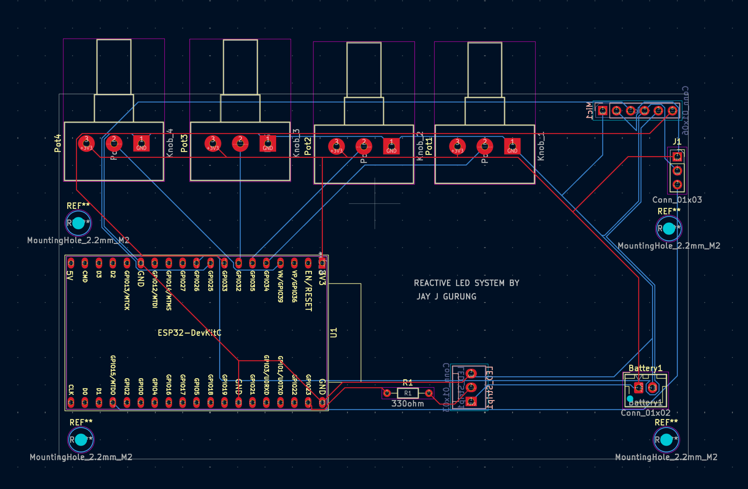
REACTIVE LED SYSTEM
3. PCB DESIGN - PCB EDITOR
Jay J Gurung
Updated PCB from Schematic and Strategically arranged ESP32, microphone, potentiometers, LEDs, and connectors for compact layout and easy wiring access.
Drew custom board shape and added screw holes for future enclosure mounting.
Routed all power, signal, and ground traces
Verified clearances, hole sizes, and track widths; fixed all unconnected nets and overlap warnings.
Exported Gerber, Drill, and Step files for PCB fabrication and 3D modeling in Fusion 360.

Slide 8

REACTIVE LED SYSTEM
3. PCB DESIGN - PCB EDITOR
Jay J Gurung

Slide 9
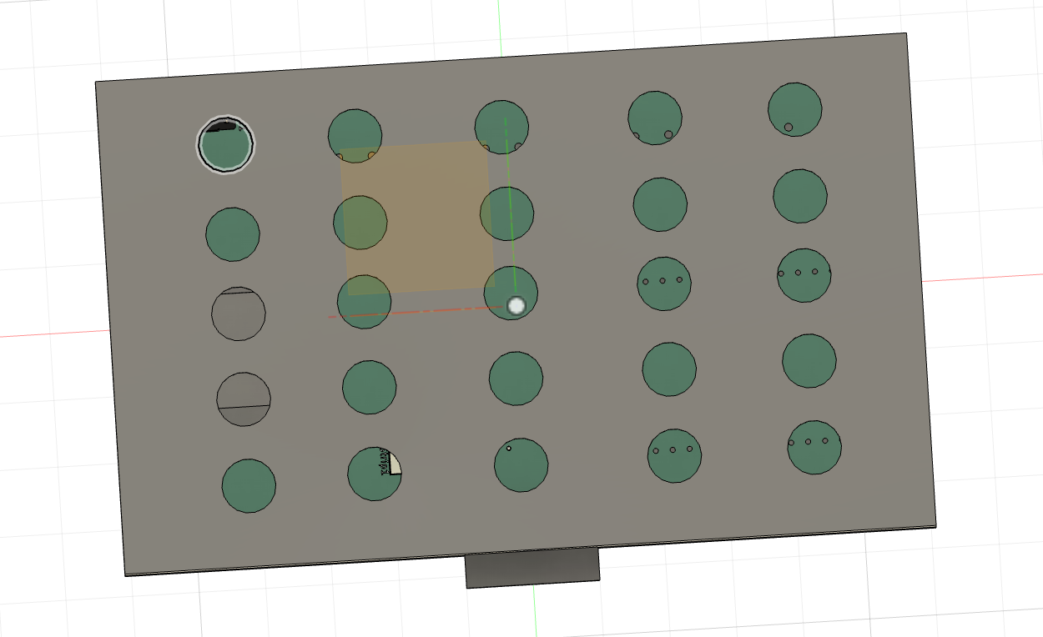
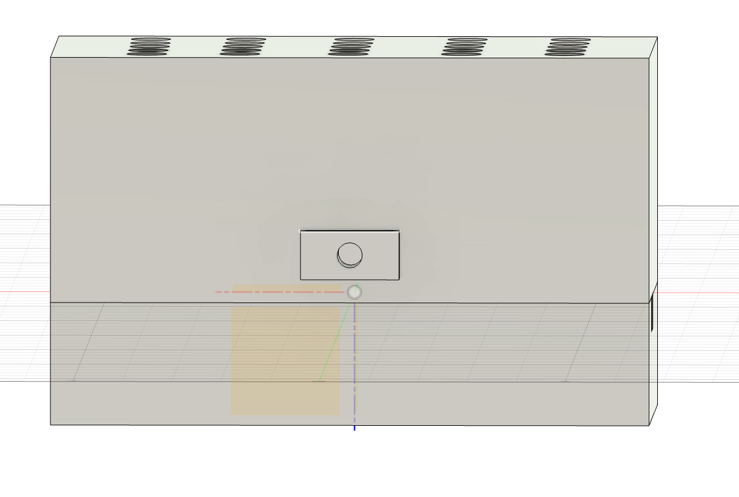
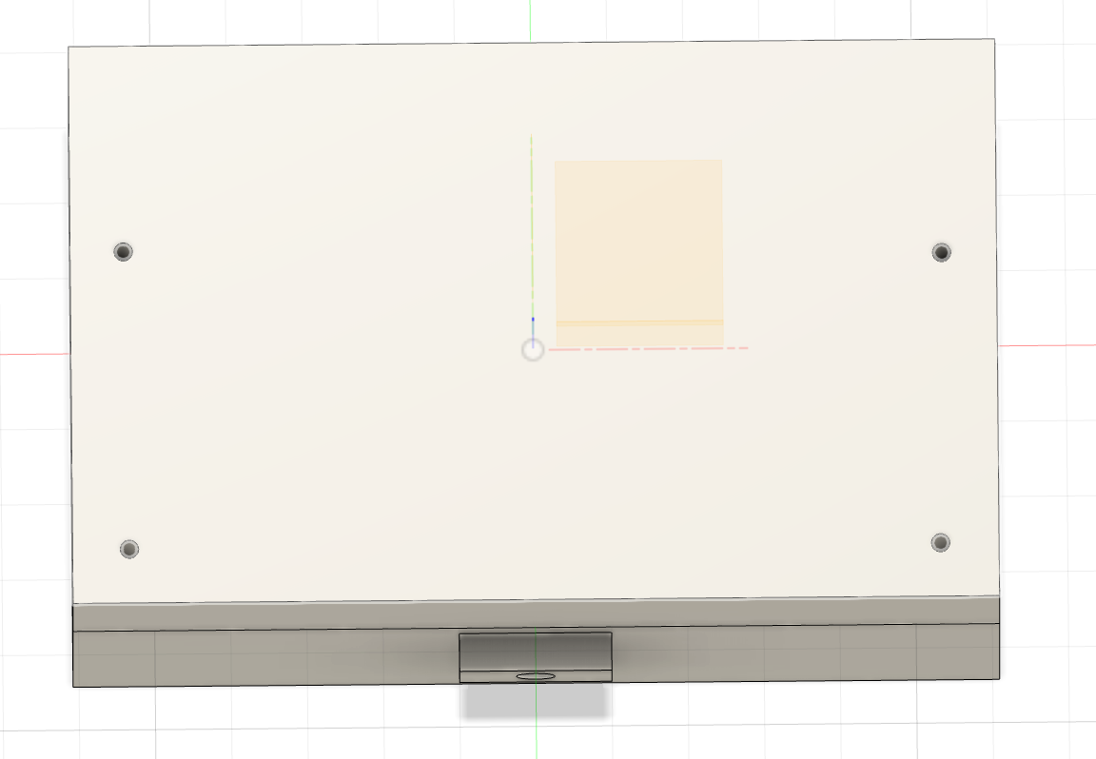
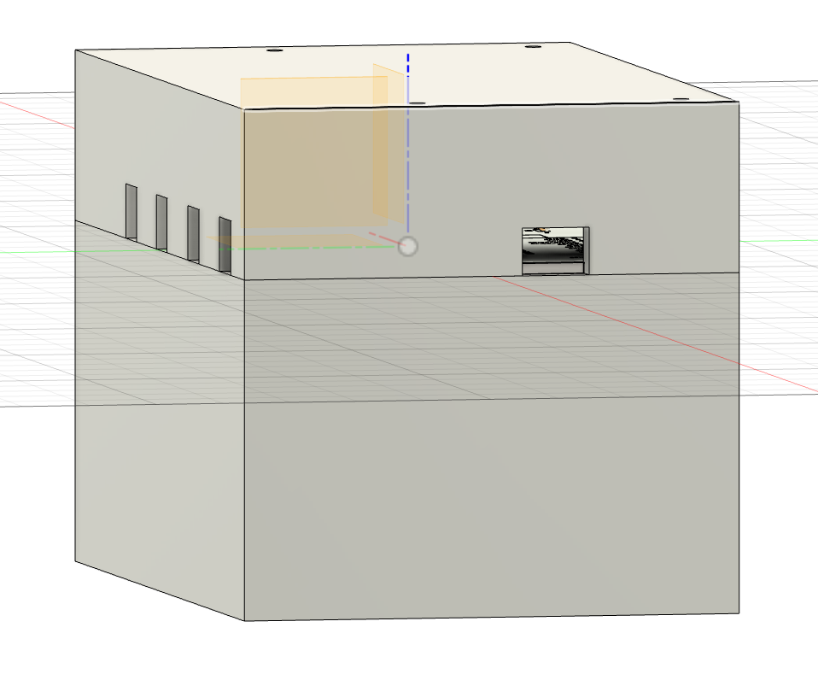
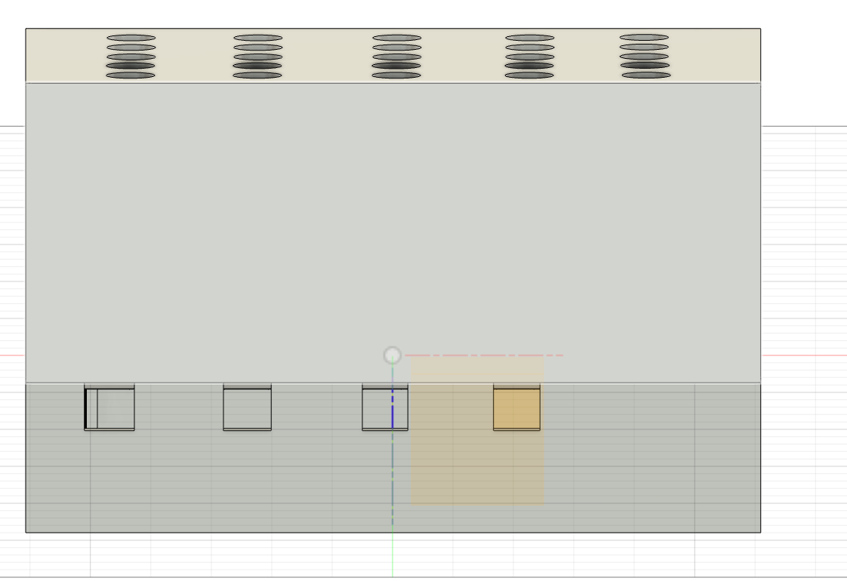
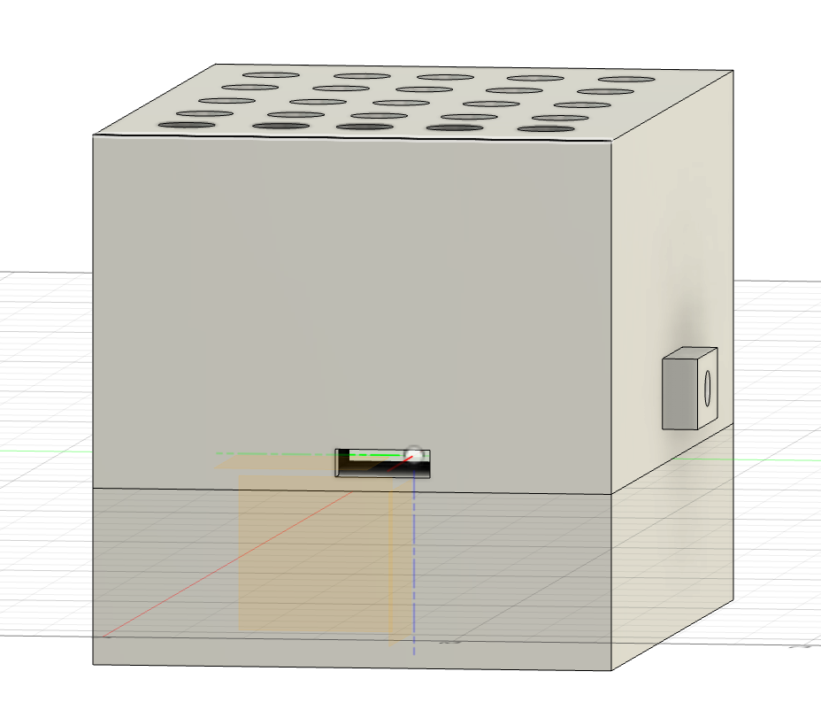
REACTIVE LED SYSTEM
4. ENCLOSURE DESIGN - Autodesk Fusion
Jay J Gurung
Front
Bottom
Back
Left
Top
Right

Slide 10
REACTIVE LED SYSTEM
4. ENCLOSURE DESIGN - Autodesk Fusion
Jay J Gurung
Demo of 3D VIEW
In Software

Slide 11
Company Name
5. NEXT STEPS
Steps
What It Does
1
Order PCBs
Submit Designs to order custom PCB board
2
3d Print
3d Print the Enclosure for the board.
3
Add More Functions
Add more functions to the system so that all the knobs are functional.
Assemble all the parts and playtest.
4
Assembly
Jay J Gurung

Slide 12
REACTIVE LED SYSTEM
THE END
Jay J Gurung

